Slide 1


[Social buzz Data Analysis]

Slide 2


Today's agenda
Project recap
Problem
The Analytics team
Process
Insights
Summary

Slide 3


Social buzz is a fast growing technology unicorn that need to adapt quickly to itsglobal scale. Accenture has begun a 3 month POC focusing on these tasks:
An Audit of Social Buzz’s big data practice
Recommendations for a successful IPO
Analysis to find Social Buzz’s top 5 most categories of content
Project Recap

Slide 4


Problem
Over 100000 posts per day
36,500,000 pieces of content per year.
But how to capitalize on it when there is so much?
Analysis to find Social Buzz’s top 5 most popular categories of content

Slide 5




Andrew Fleming
(Chief Technical Architect)
The Analytics team
Marcus Rompton (Senior Principle)
Siddhi Tarmale
(Data Analyst)

Slide 6

Process
1
Data loading & understanding
2
Data Cleaning
3
Data Modelling
4
Data Analysis
5
Insights

Slide 7

Data loading & understanding:
Load the each dataset in excel & understand the linkage between three different datasets.
Like we can connect data models using comman columns eg.Content ID, Type,Category etc
Data Cleaning:
Removed the empty/Null columns & Rows from each dataset
Delete the unwanted column which are not useful for the data analysis. Eg.URL,UserID

Slide 8
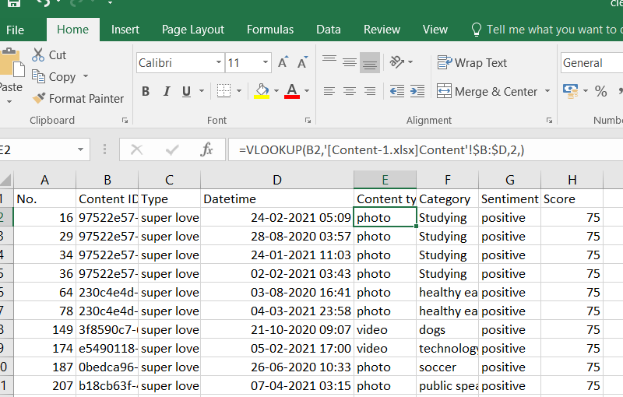
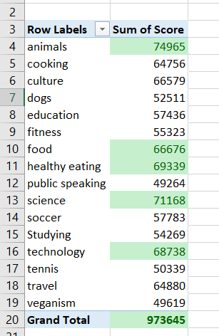
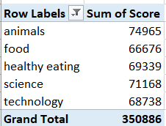
Data Modelling:
Integrate the clean dataset in one excel spreadsheet using Vlookup method as shown in figure.
Rearrange Scorecard columns by highest to lowest
Data Analysis:
We can drawn analysis from clean dataset sheet which can also refer for the Audit purpose.
From the shown Pivot table fig. we can simply analyze that categories like Animals, Science, Healthy eating, Technology & Food are the Social Buzz’s top 5 most categories of content which is highlighted by green color using conditional formatting.

Slide 9
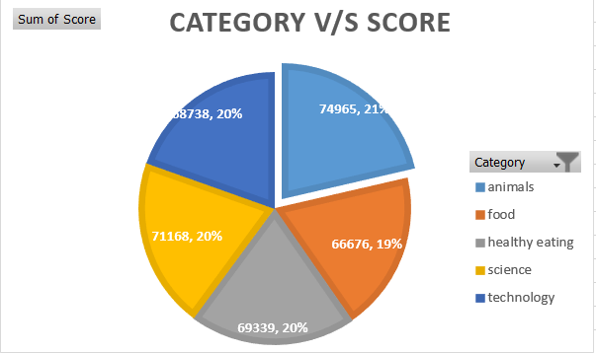
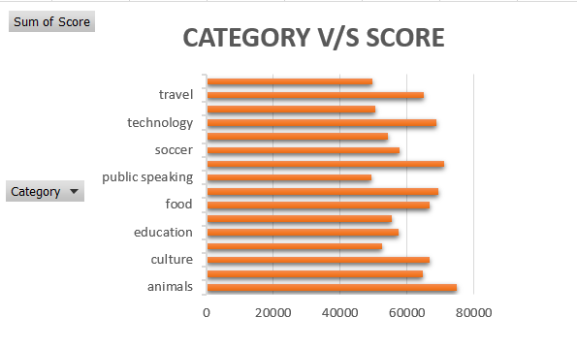

Insights:
Animal & Science are the two most popular content.
The lower shares of categorical content eg. Veganism, Dogs, Public speaking etc should be more promoted using #Hashtag Campaigns to run the more successful IPO in future.
Public speaking should encourage by creating awareness among users by running knowledge drives & speakup campaigns.

Slide 10


An IPO cannot run successfully without analyzing the data. Data wrangling plays an important role here to interprete the data flaws, Quality Assurance reports & to predict the future business insights .
Summary

Slide 11

Thank you!
ANY QUESTIONS?

